Slide 1
Nutrition Basics
Chapter 12

Slide 2
Nutrition Basics
Objectives
Vocabulary
Relate earlier scientific findings to today’s understanding of nutrition.
Explain the role of respiration and oxidation in nutrition.
Identify and briefly describe essential nutrients.
Explain how different nutritional guidelines are formulated and used.
Choose healthful foods according to the Dietary Guidelines for Americans.
Demonstrate how to use food labels to compare nutrients in foods.
Plan healthful menus using nutrition guidelines.
Relate the understanding of nutrition to physical well-being.
Daily Values (DVs)
Dietary Reference Intakes (DRIs)
Enzymes
Essential nutrients
Nu8trient dense
Nutrients
Nutrition
Oxidation
Recommended Dietary Allowances (RDAs)
Respiration
scurvy

Slide 3
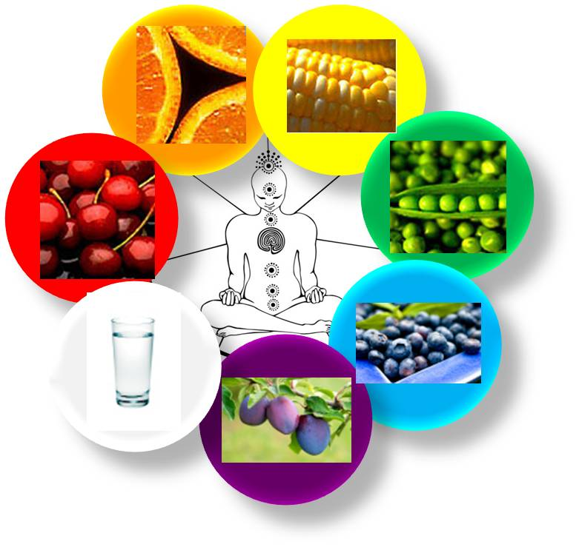
Nutrition History Highlights
Ancient people credited food for having magical powers
Around 400 B.C., Hippocrates, “the father of modern medicine,” taught that people could learn what was good for them by reasoning from observable facts
Studies led him to believe that foods contain life-giving substance
Not until the mid 1700’s that the scientific method proved him right

Slide 4
An Early Discovery
British sailors suffered from lack of Vitamin C, which caused circulatory disease, bleeding gums, weakened blood vessels, and extreme fatigue. This was also fatal.
The name for this condition was scurvy.
A physician set up an experiment to find a cure and the illness only disappeared in the sailors that ate lemons and limes.
This experiment gave the sailors a nickname called limeys, which is applied to British citizens today.
Notes:
In 1740, a physician set out to find a cure. He chose a group of twelve British sailors who had the illness to eat a variety of foods, including limes, lemons, cider, vinegar, seawater , nutmeg, an oil of vitriol.

Slide 5
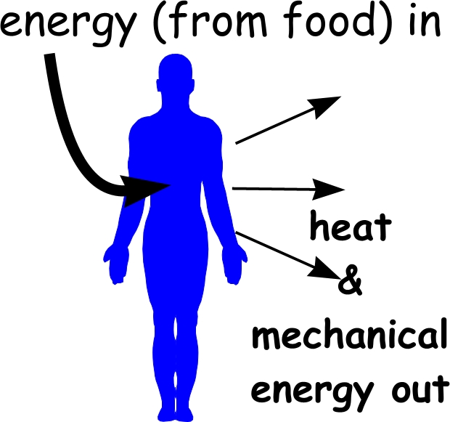
Oxidation and Respiration
Chemist Antoine Lavoisier discovered that burning things required a certain gas which he named oxygen.
Oxidation is the chemical reaction in which elements combine with oxygen. http://www.youtube.com/watch?v=FWNj-9vg4o0
Lavoisier also suspected that living organisms also use oxygen to create heat energy, similar to a candle.
Living organisms (humans) are made up of carbon compounds.
As organisms take in oxygen from the air, the carbon and hydrogen in their cells oxidize. Carbon dioxide and water vapor form during the reaction, releasing heat energy. The heat maintains body temperature and provides energy for organisms (humans) activities. This process is known as respiration.
Notes:
Use an apple to show the oxidation process.

Slide 6
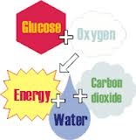
Respiration Continued
Lavoisier believed that what the body loses during respiration is replenished by nourishment of food. Thus, the study of nutrition was launched.
http://www.youtube.com/watch?v=i8c5JcnFaJ0
Because of his work, Lavoisier is know as “the father of nutrition”

Slide 7
Elements of Nutrition
Nutrition – the science of how the body uses food
Nutrients – substances that are found in food and need by the body to function, grow repair itself and produce energy. Nutrients are the fuel for cell activity.

Slide 8
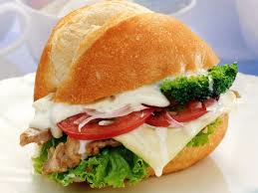
Essential Nutrients
Water
Carbohydrates
Proteins
Fats/Lipids
Vitamins
Minerals

Slide 9
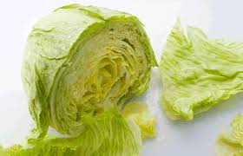
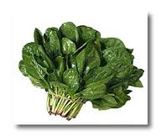
Nutrient Dense
Nutrient dense food supply many nutrients that are critical to good health in comparison to their low-to-moderate number of calories.

Slide 10
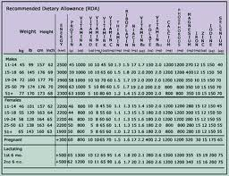
RDA’s
(RDA) Recommended Dietary Allowances – Is a table supplied by the US government to give adequate amounts of specific nutrients needed by most healthy people.
First established over fifty years ago.
Supplies a detailed description of nutrient needs of eighteen population groups.
Currently covers protein, ten vitamins and seven minerals
Notes:
Pass around packets of the RDA’s for students to look at.

Slide 11
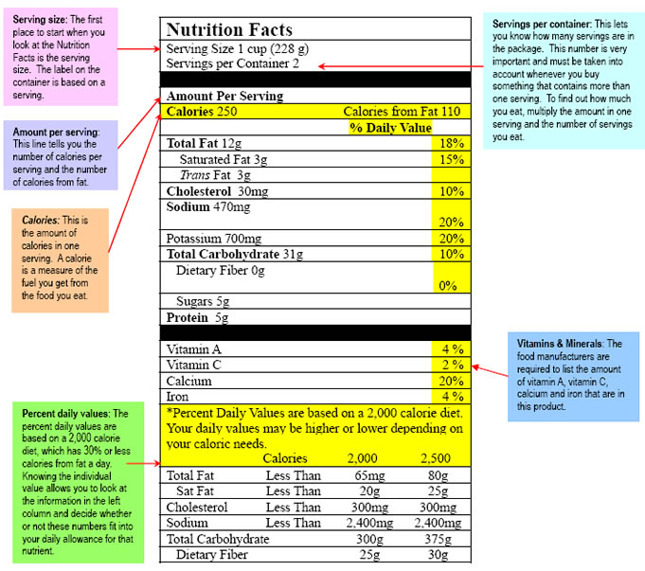
Food Labeling

